Slide 1
Sales of Biotechnology Products and Forecast
Team 3: Meichen Wang, Yuzhao Xie, Di Lu
Mohan Jiang, Jianyue Zhu

Slide 2
Contents
Introduction
Modeling & Analysis
Visualization
Prediction
Conclusion

Slide 3
01
Introduction

Slide 4
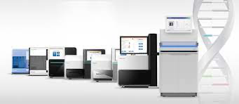
Introduction
A biotechnology company develops, manufactures, and markets integrated systems for the analysis of genetic variation and biological function. We collected and analyzed data on the sales of DNA sequencing instrument.

Slide 5
Genomics Applications
Genotyping
Genotyping is a popular and effective way to screen for SNPs and structural variations across the genome. Our technology offers accuracy, reproducibility, and flexibility with content selection.
Gene Expression and Transcriptome Analysis
The technologies enable characterization of all transcriptional activity (coding and non-coding), or focusing on a select subset of RNA transcripts within a given sample for high-quality gene expression and transcriptome analysis.
Epigenetics
We offers a broad portfolio of simple-to-use, cost-efficient epigenetic analysis tools for studying epigenetic modifications and their impact on gene regulation.
Genome Editing
NGS enables researchers to discover CRISPR genome editing off-target effects, confirm gene knockouts, and assess the functional impact of edits.

Slide 6
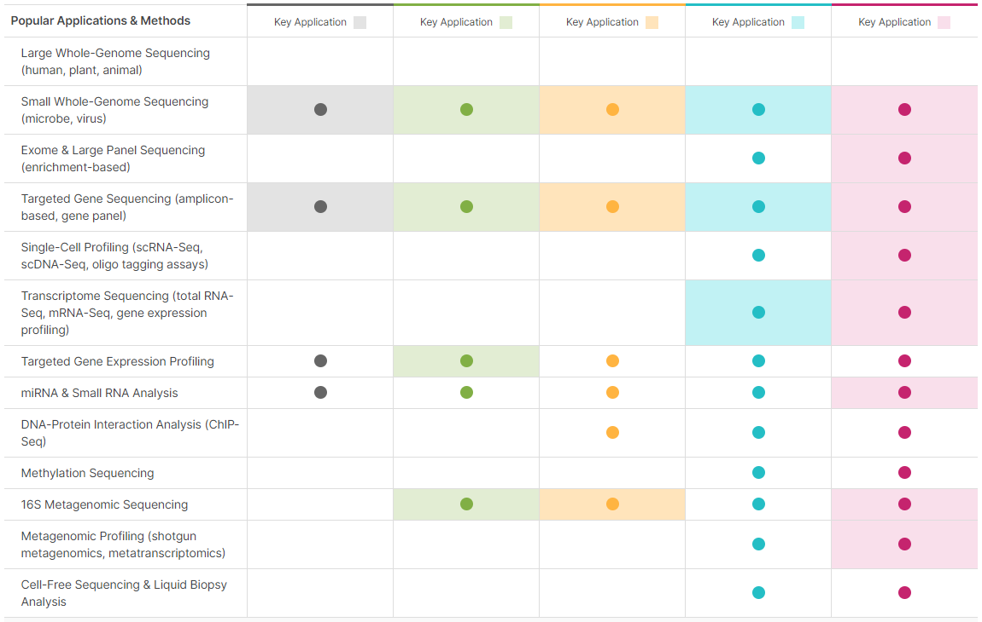
Introduction
G
F
E
D
C
$10k
$40k
$125k
$270k
$320k

Slide 7
02
Modeling & Analysis

Slide 8
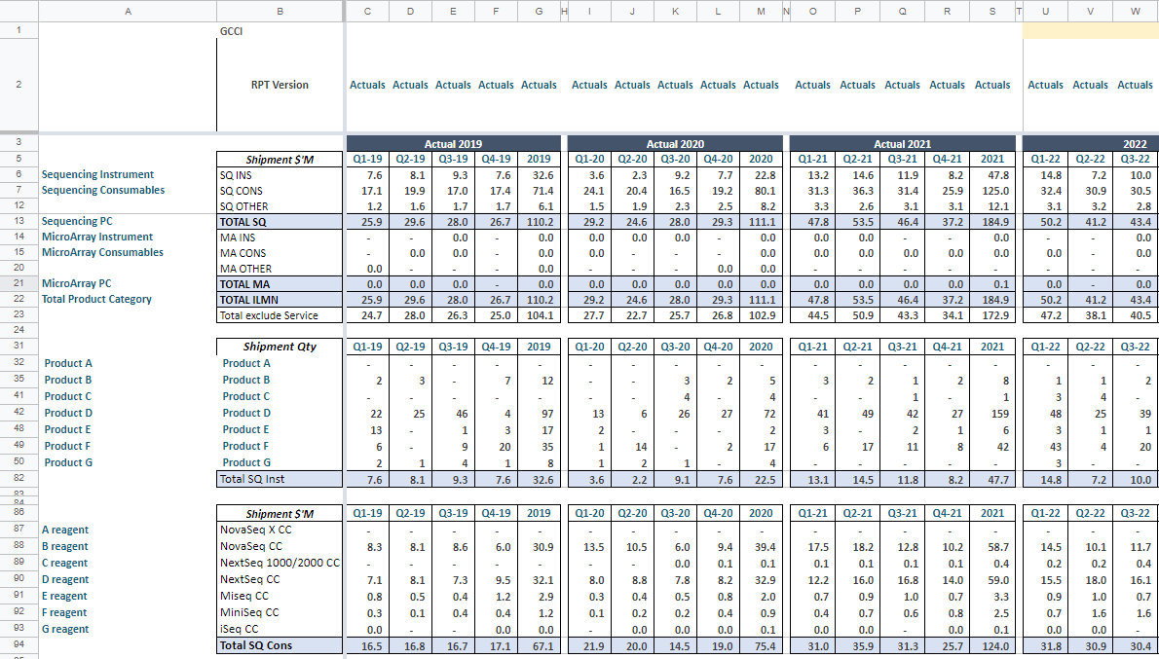
DATA

Slide 9
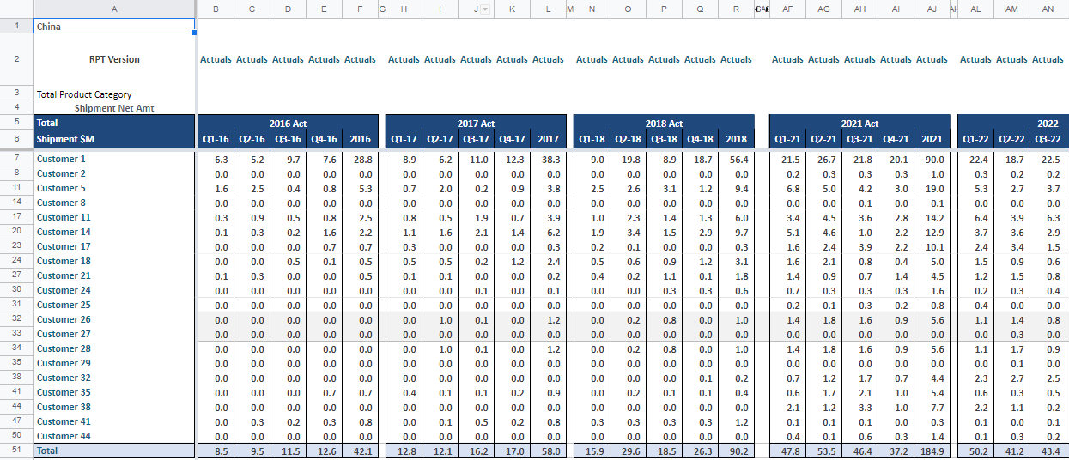
DATA

Slide 10
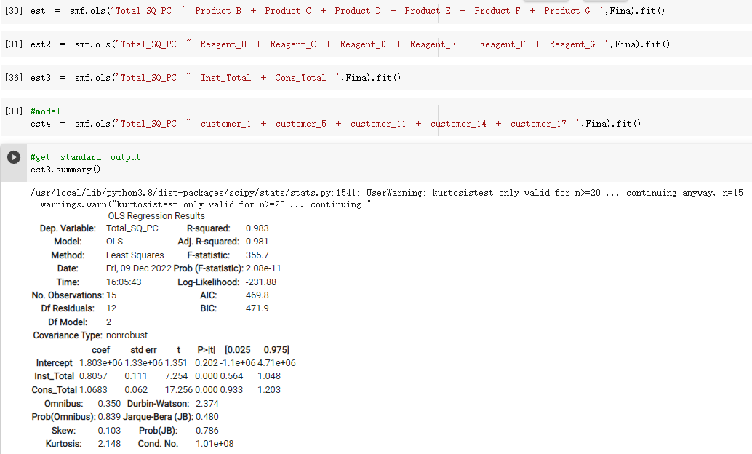
Modeling & Analysis
Model 1：Saling Amount

Slide 11
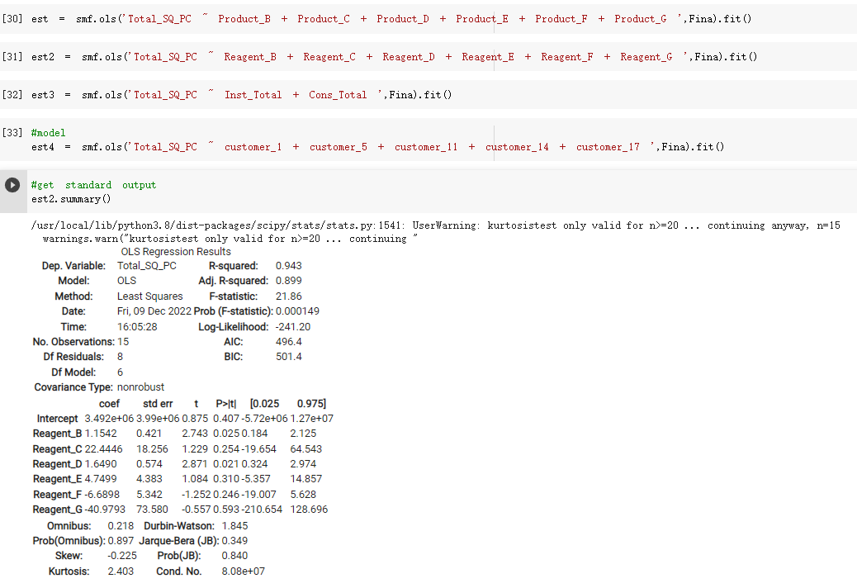
Modeling & Analysis
Model 2： Consumables

Slide 12
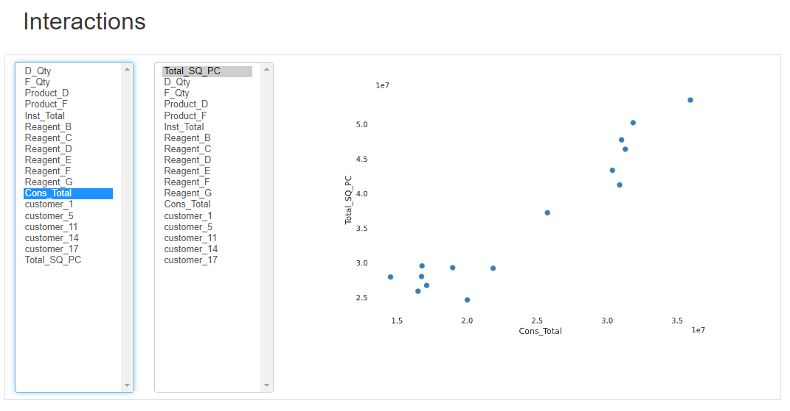
Modeling & Analysis
Model 2： Consumables

Slide 13
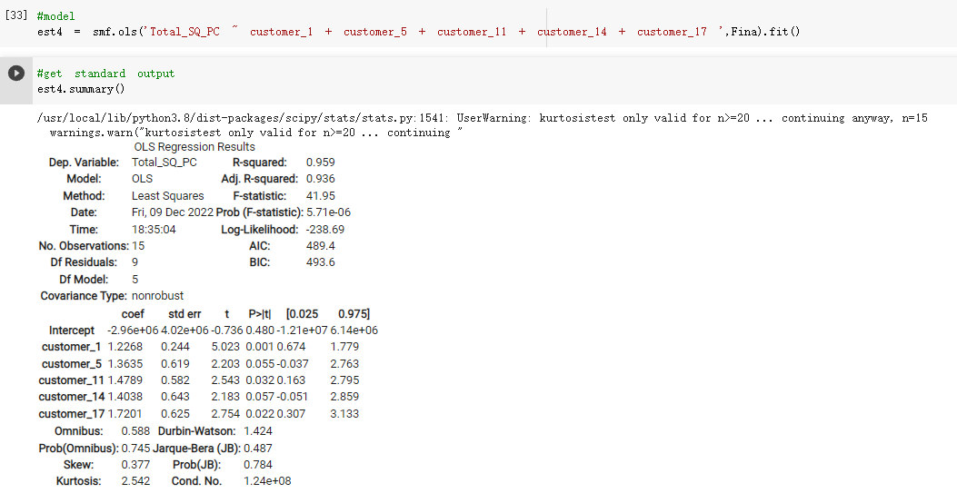
Modeling & Analysis
Model 3：Customers
Total_SQ_PC = 1.2268*customer_1 + 1.363* customer_2
+1.4789*customer_11 + 1.4038*customer_14
+ 1.7201*cusomer_17

Slide 14
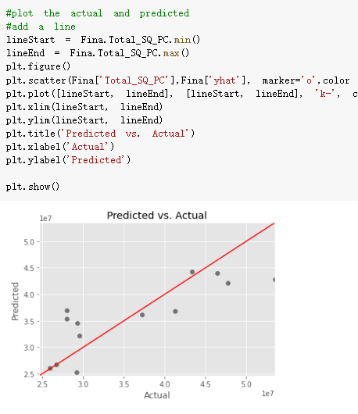
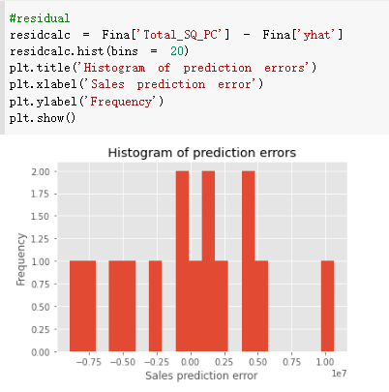
Modeling & Analysis
Model 3：Customers

Slide 15
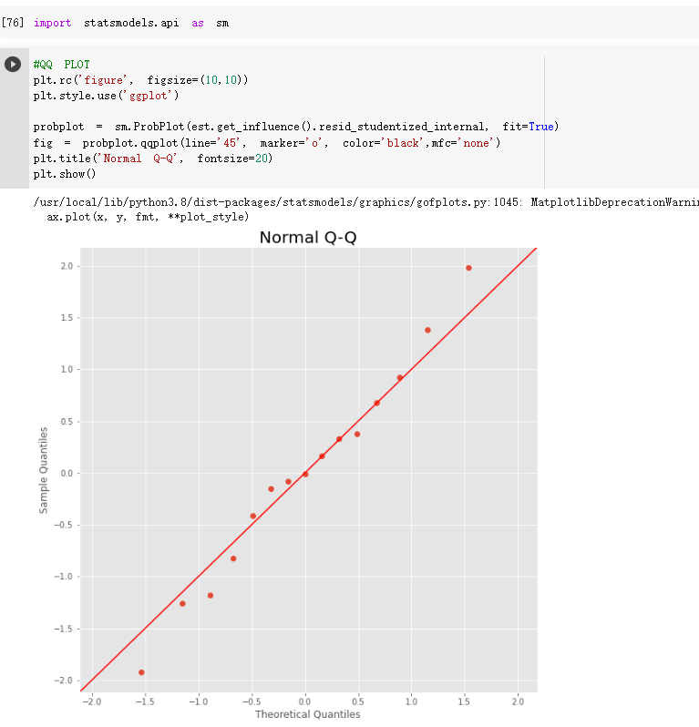
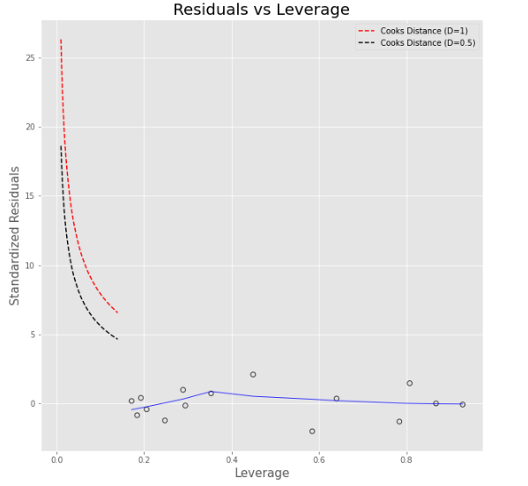
Modeling & Analysis
Model 3：Customers

Slide 16
03
Visualization

Slide 17
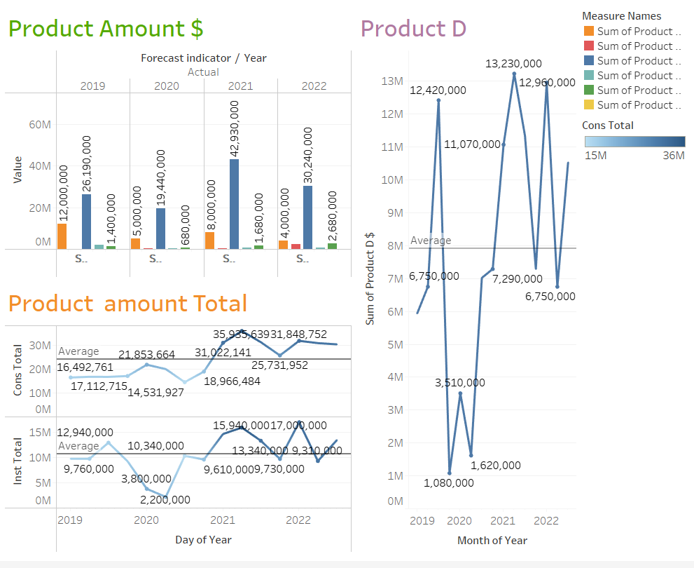
Visualization

Slide 18
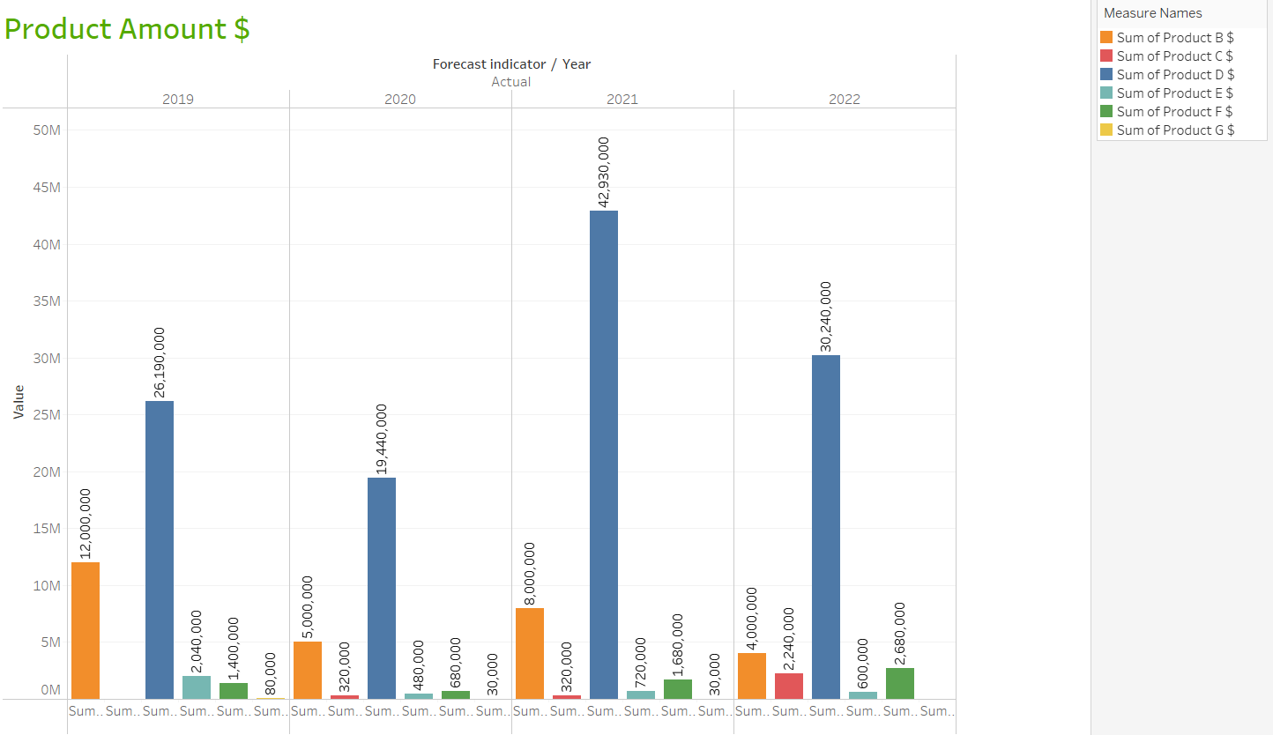
Visualization

Slide 19
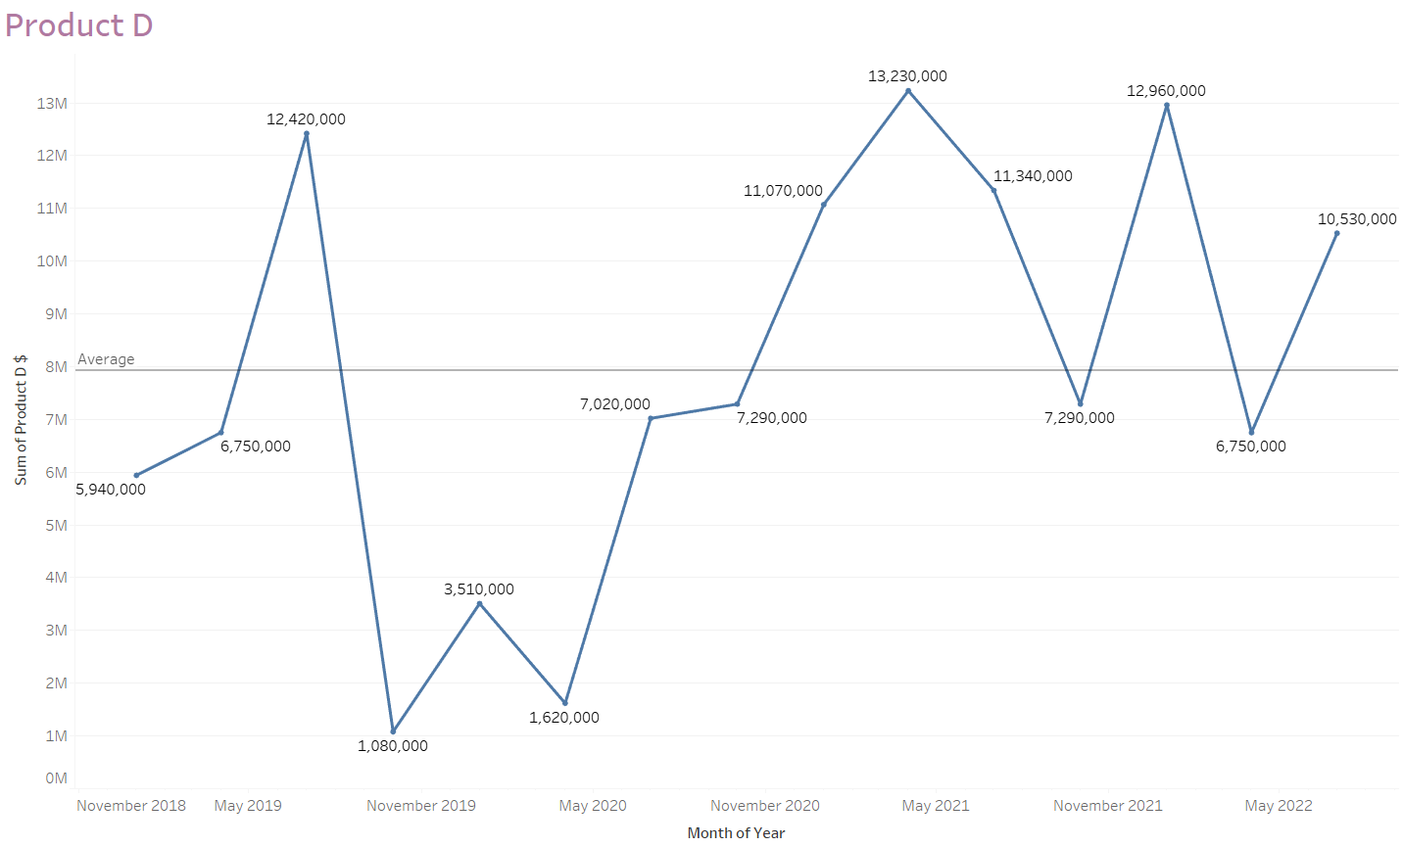
Visualization

Slide 20
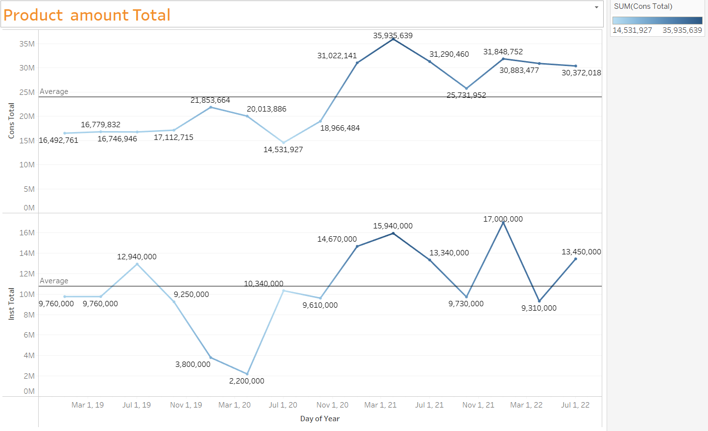
Visualization

Slide 21
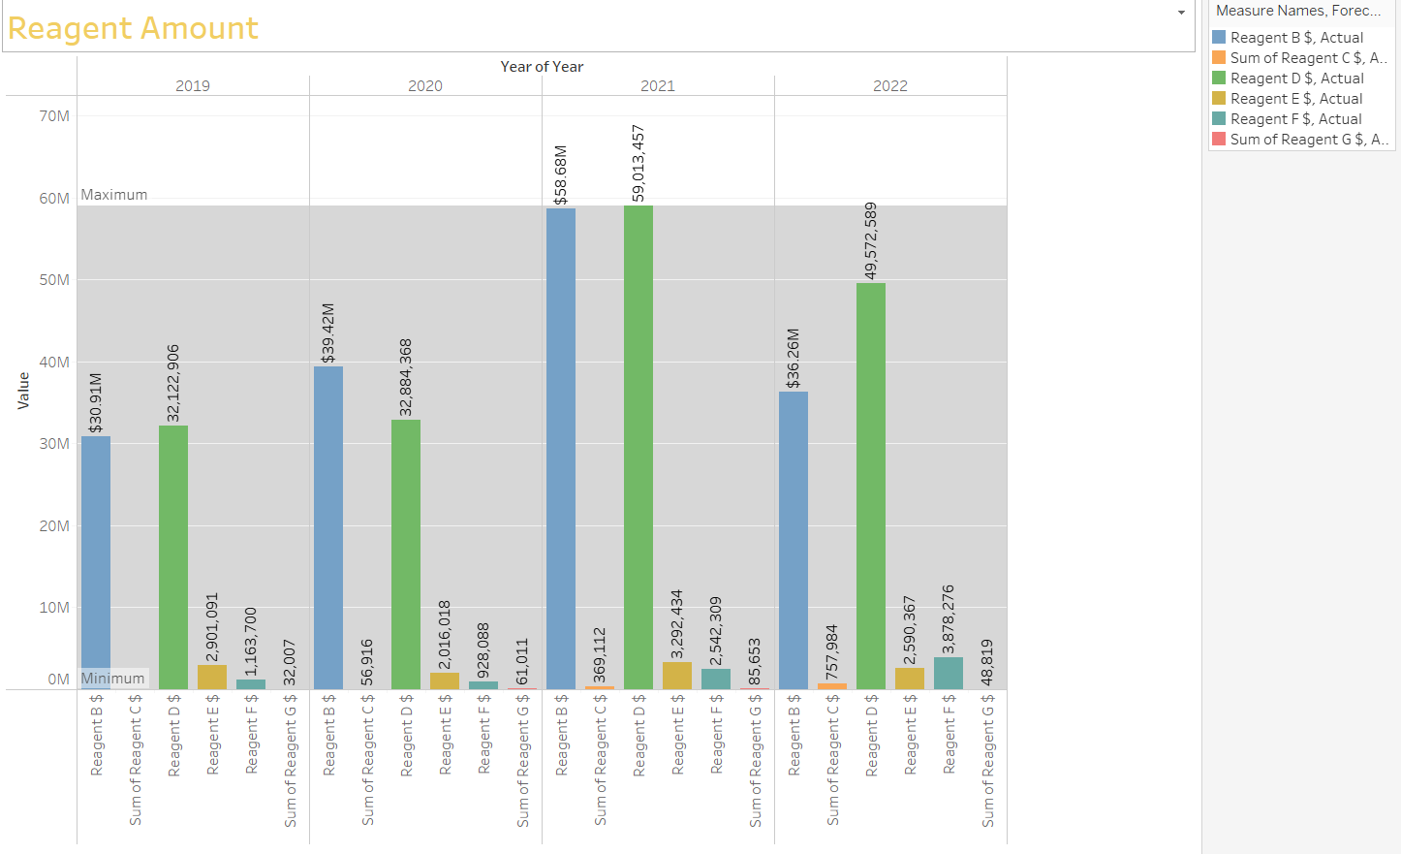
Visualization

Slide 22
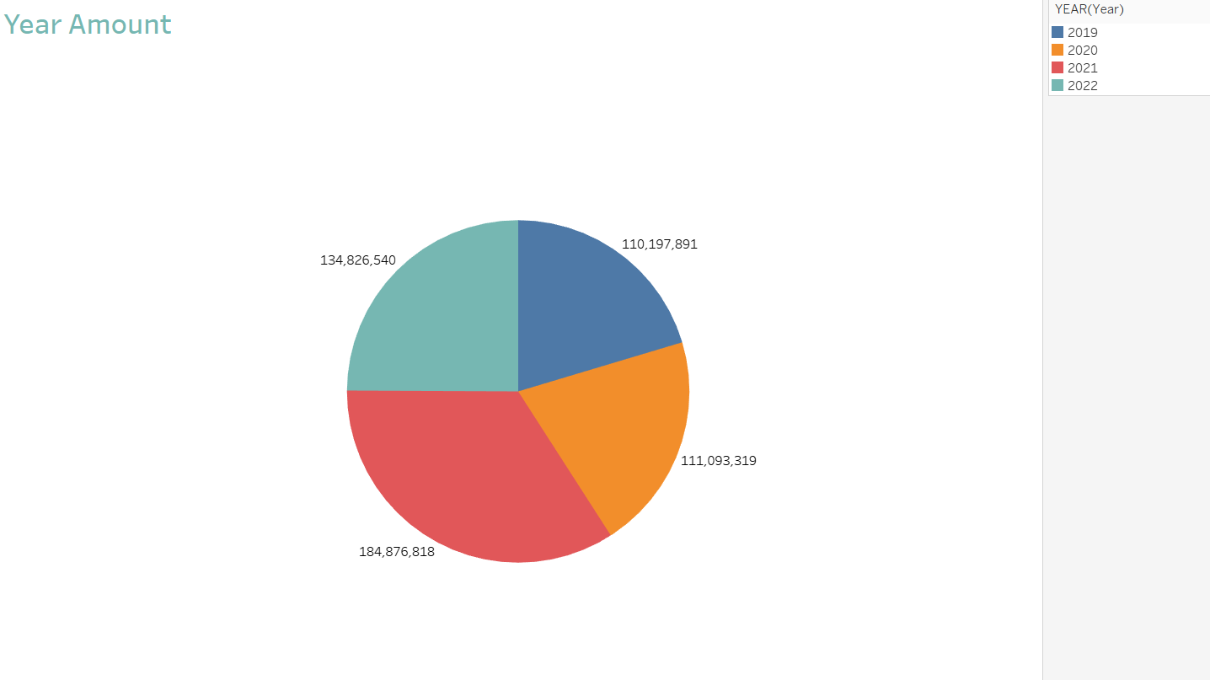
Visualization

Slide 23
04
Prediction

Slide 24
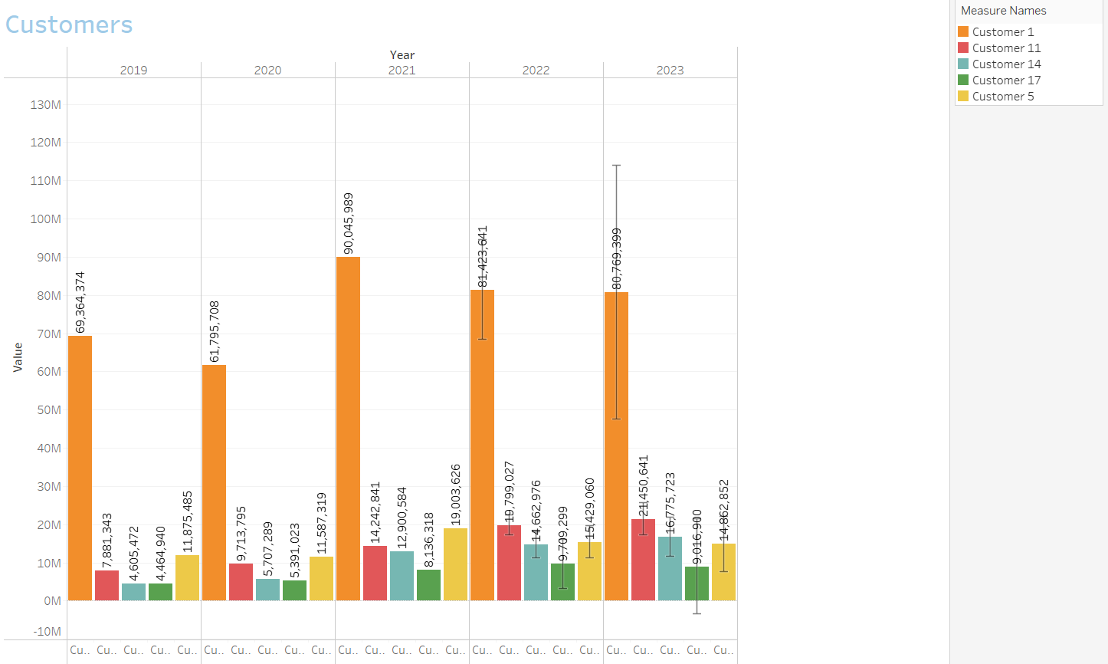
Prediction

Slide 25
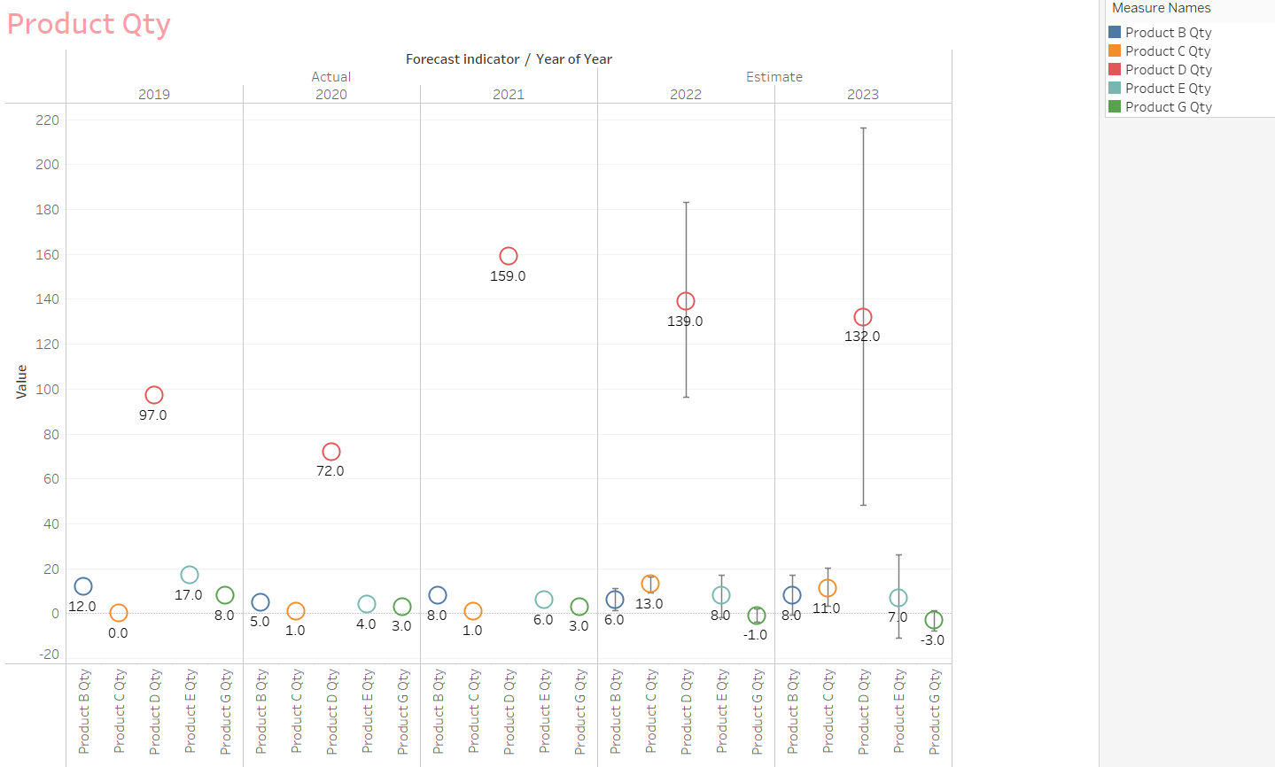
Prediction

Slide 26
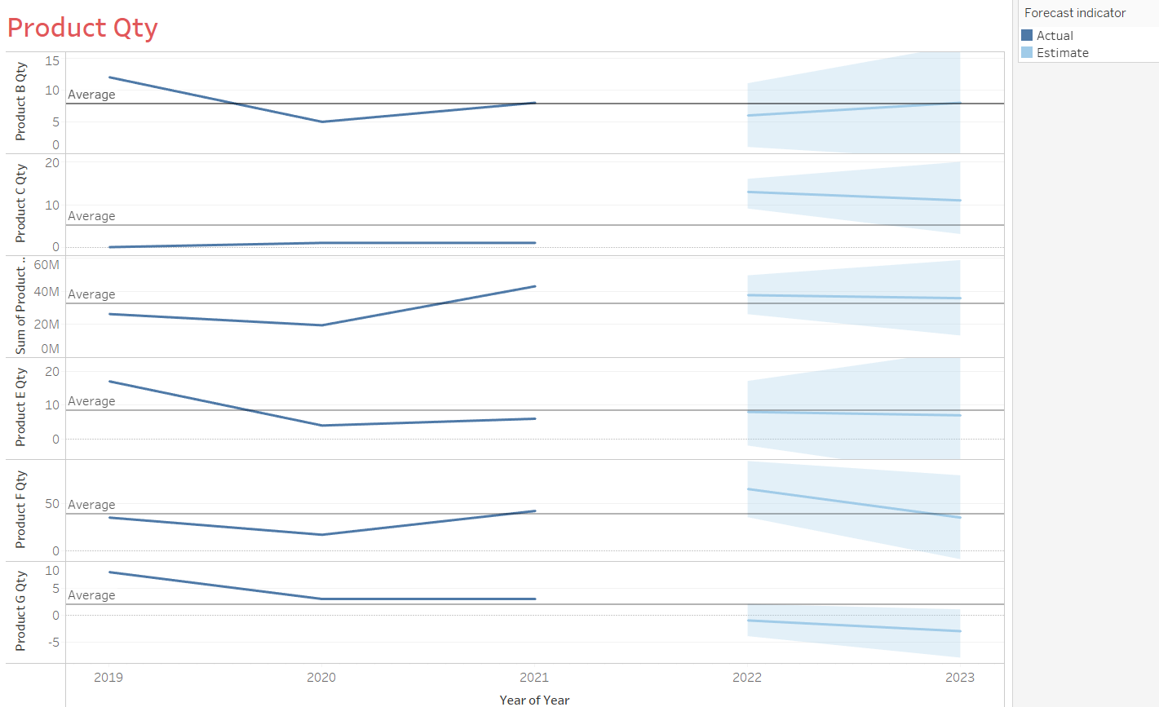
Prediction

Slide 27
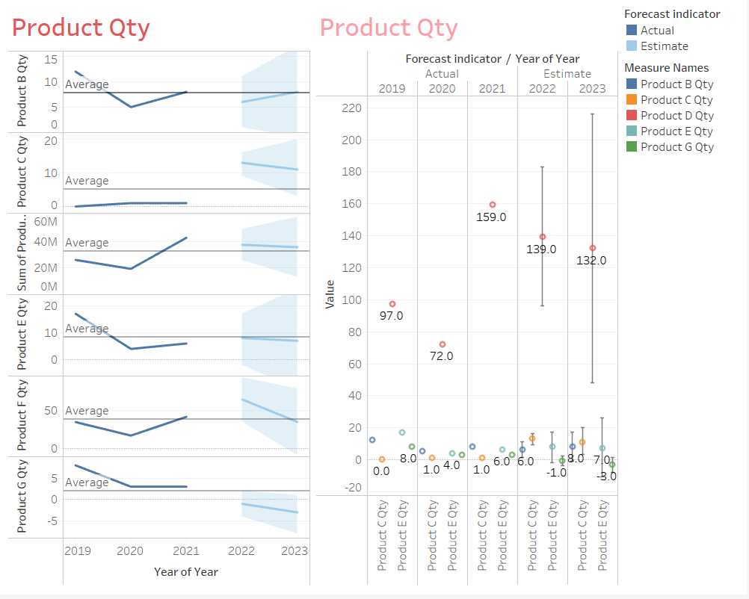
Prediction

Slide 28
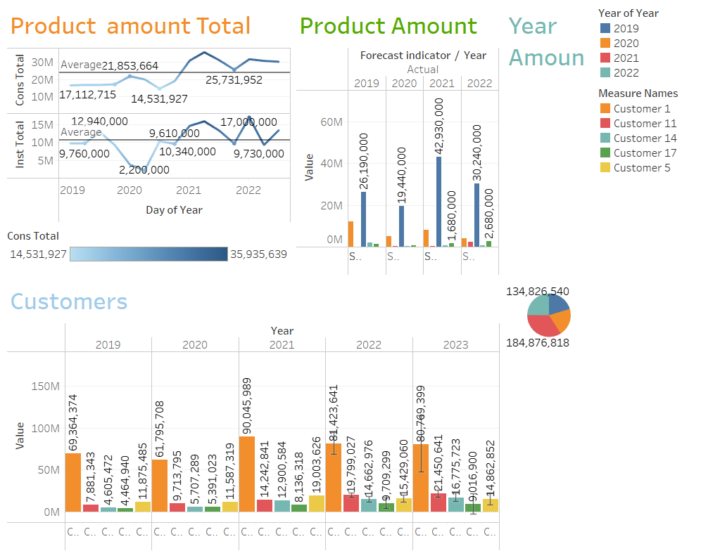
Prediction

Slide 29
05
Conclusion

Slide 30
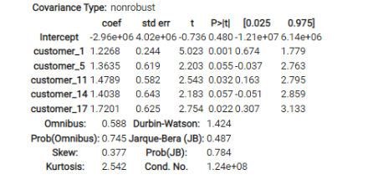
Bio-Tech
The P-Values for all five customers are small
Customer_1 has the smallest P-value, close to 0.001

Slide 31
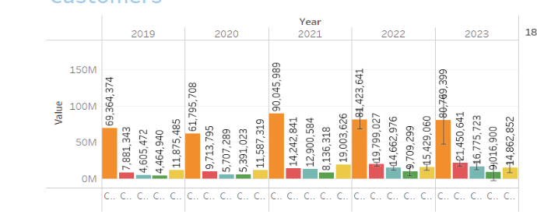
The sales of all products are increasing
We predict that the increasing rate for 2023 will be approximately 20%

Slide 32
Business steps & Analysis deficiencies
investigate the demand of potential customers
data collection & data cleaning

Slide 33
Thanks

